Slide 1
Book1
File created on: 25-04-2019 01:23:51

Slide 2
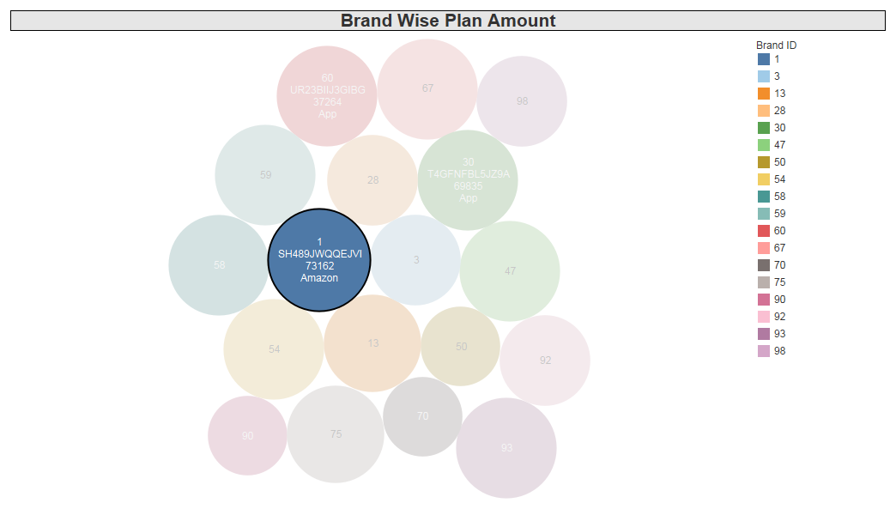

Slide 3
